Slide 1
Inheritance & Polymorphism

Slide 2
Inheritance

Slide 3
Contents of grade.h
#ifndef GRADE_H
#define GRADE_H
// Grade class declaration
class Grade
{
private:
char letter;
float score;
void calcGrade(void);
public:
void setScore(float s) { score = s; calcGrade();}
float getScore(void) {return score; }
char getLetter(void) { return letter; }
};
#endif

Slide 4
Contents of test.h
#ifndef TEST_H
#define TEST_H
// Test class declaration
class Test {
private:
int numQuestions;
float pointsEach;
int numMissed;
public:
Test(int, int);
};
#endif

Slide 5
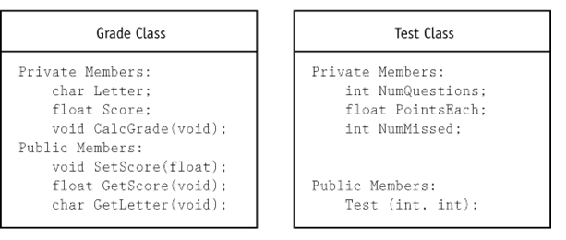
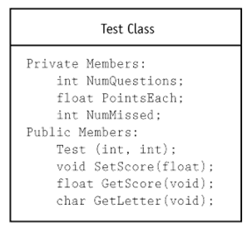
Contents of test.h
#ifndef TEST_H
#define TEST_H
#include "grade.h" // Must include Grade class declaration.
// Test class declaration
class Test : public Grade
{
private:
int numQuestions;
float pointsEach;
int numMissed;
public:
Test(int, int);
};
#endif

Slide 7
Passing Arguments to Base Class Constructors
Assume a class called Cube is derived from a class called Rect. Here is how the constructor looks in Rect:
Rect::Rect(float w, float l)
{
width = w;
length = l;
area = length * width;
}

Slide 8
Cube constructor:
Cube::Cube(float wide, float long, float high) : Rect(wide, long)
{
height = high;
volume = area * high;
}

Slide 9
General Form:
<class name>::<class name>(parameter list) : <base class name> (parameter list)
Note that the derived class constructor must take enough arguments to be able to pass to the base class constructor

Slide 10
Inheritance & Constructor Ordering
class A {
public:
A(int i) :m_i(i) {
cout << "A“ << endl;}
~A() {cout<<"~A"<<endl;}
private:
int m_i;
};
class B : public A {
public:
B(int i, int j) :A(i), m_j(j) {
cout << “B” << endl;}
~B() {cout << “~B” << endl;}
private:
int m_j_;
};
int main (int, char *[]) {
B b(2,3);
return 0;
};
Class and member construction order
B constructor called on object b in main
Passes integer values 2 and 3
B constructor calls A constructor
passes value 2 to A constructor via initializer list
A constructor initializes member m_i
with passed value 2
Body of A constructor runs
outputs “A”
B constructor initializes member m_j
with passed value 3
Body of B constructor runs
outputs “B”

Slide 11
Inheritance & Destructor Ordering
class A {
public:
A(int i) :m_i(i) {
cout << "A“ << endl;}
~A() {cout<<"~A"<<endl;}
private:
int m_i;
};
class B : public A {
public:
B(int i, int j) :A(i), m_j(j) {
cout << “B” << endl;}
~B() {cout << “~B” << endl;}
private:
int m_j_;
};
int main (int, char *[]) {
B b(2,3);
return 0;
};
Class and member destructor order:
B destructor called on object b in main
Body of B destructor runs
outputs “~B”
B destructor calls member m_j “destructor”
int is a built-in type, so it’s a no-op
B destructor calls A destructor
Body of A destructor runs
outputs “~A”
A destructor calls member m_i destructor
again a no-op
Compare dtor and ctor order
at the level of each class, the order of steps is reversed in ctor vs. dtor
ctor: base class, members, body
dtor: body, members, base class

Slide 12
Virtual Functions
class A {
public:
A () {cout<<" A";}
virtual ~A () {cout<<" ~A";}
};
class B : public A {
public:
B () :A() {cout<<" B";}
virtual ~B() {cout<<" ~B";}
};
int main (int, char *[]) {
// prints "A B"
A *ap = new B;
// prints "~B ~A" : would only
// print "~A" if non-virtual
delete ap;
return 0;
};
Used to support polymorphism with pointers and references
Declared virtual in a base class can be overridden in derived class
Overriding only happens when signatures are the same
Otherwise it just overloads the function or operator name
Ensures derived class function definition is resolved dynamically
E.g., that destructors farther down the hierarchy get called

Slide 13
Virtual Functions
class A {
public:
void x() {cout<<"A:x";};
virtual void y() {cout<<"A:y";};
};
class B : public A {
public:
void x() {cout<<"B:x";};
virtual void y() {cout<<"B:y";};
};
int main () {
B b;
A *ap = &b; B *bp = &b;
b.x (); // prints "B:x"
b.y (); // prints "B:y"
bp->x (); // prints "B:x"
bp->y (); // prints "B:y"
ap.x (); // prints "A:x"
ap.y (); // prints "B:y"
return 0;
};
Only matter with pointer or reference
Calls on object itself resolved statically
E.g., b.y();
Look first at pointer/reference type
If non-virtual there, resolve statically
E.g., ap->x();
If virtual there, resolve dynamically
E.g., ap->y();
Note that virtual keyword need not be repeated in derived classes
But it’s good style to do so
Caller can force static resolution of a virtual function via scope operator
E.g., ap->A::y(); prints “A::y”

Slide 14
Pure Virtual Functions
class A {
public:
virtual void x() = 0;
virtual void y() = 0;
};
class B : public A {
public:
virtual void x();
};
class C : public B {
public:
virtual void y();
};
int main () {
A * ap = new C;
ap->x ();
ap->y ();
delete ap;
return 0;
};
A is an Abstract Base Class
Similar to an interface in Java
Declares pure virtual functions (=0)
Derived classes override pure virtual methods
B overrides x(), C overrides y()
Can’t instantiate class with declared or inherited pure virtual functions
A and B are abstract, can create a C
Can still have a pointer to an abstract class type
Useful for polymorphism

Slide 15
Notes on virtual
If a method is declared virtual in a class,
… it is automatically virtual in all derived classes
It is a really, really good idea to make destructors virtual!
virtual ~Shape();
Reason: to invoke the correct destructor, no matter how object is accessed

Slide 16
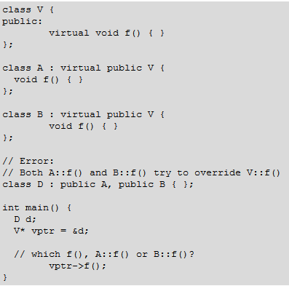
Notes on virtual
You cannot override one virtual function with two or more ambiguous virtual functions

Slide 17
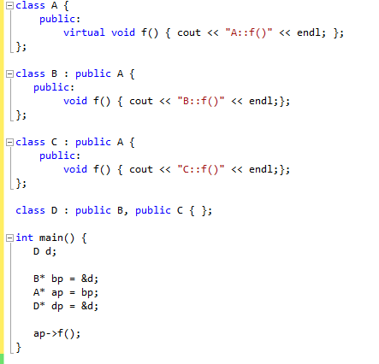
Notes on virtual
What about this?

Slide 18
The “using” declaration and class members
A using declaration in a definition of a class A allows you to introduce a name of a data member or member function from a base class of A into the scope of A
A using declaration in a class A may name one of the following:
A member of a base class of A
A member of an anonymous union that is a member of a base class of A
An enumerator for an enumeration type that is a member of a base class of A

Slide 19
Using Declaration
When to use?
if you want to create a set of overloaded member functions from base and derived classes
If you want to change the access of a class member

Slide 20
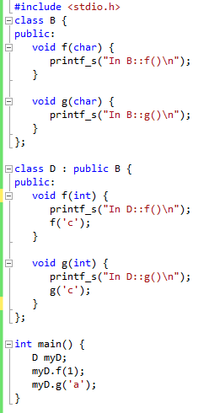
What is the output?

Slide 21
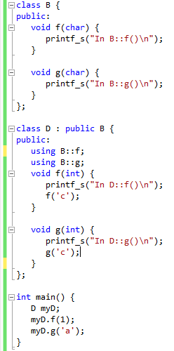
Now, What is the output?

Slide 22
Another example: Using declaration
class C {
protected:
int y;
public:
int z;
};
class B : public C {
};
int main() {
B obj_B;
obj_B.y =10;
obj_B.z=8;
}
Using can be used to change the access
Level of derived class objects on base
Class members

Slide 23
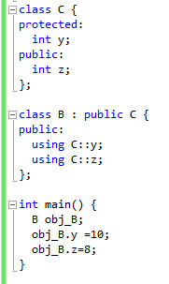
Using: changing the access level

Slide 24
More examples: is this valid?
class C {
private:
int y;
public:
int z;
};
class B : public C {
using C::y;
using C::z;
};
int main() {
B obj_B;
obj_B.y =10;
obj_B.z=8;
}

Slide 25
Notes on “using”
You cannot restrict the access to x with a using declaration
You may increase the access of the following members:
A member inherited as private. (You cannot increase the access of a member declared as private because a using declaration must have access to the member's name.)
A member either inherited or declared as protected

Slide 26
Why is there the “PRIVATE” inheritance?
To reduce access to base class members, and functionalities from the child class
To simulate composition (inclusion)

Slide 27
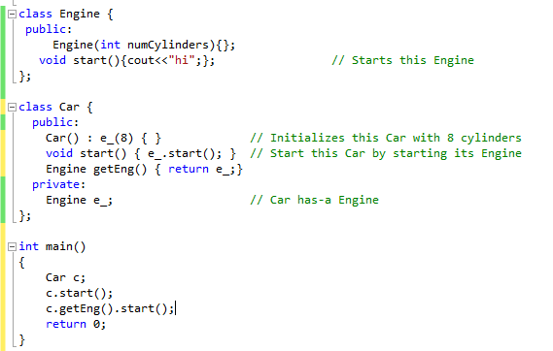
Composition
the "Car has-a Engine" relationship can be expressed using simple composition

Slide 28
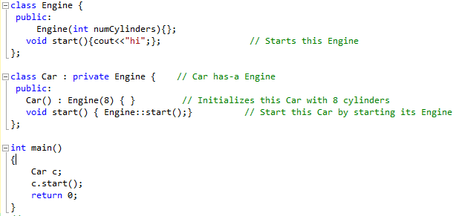
Inclusion
The "Car has-a Engine" relationship can also be expressed using private inheritance:

Slide 29
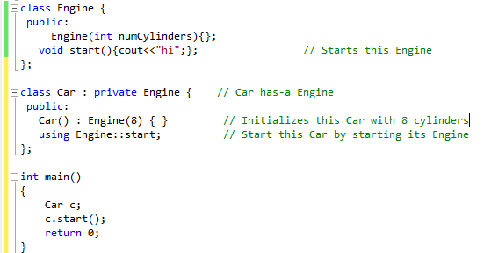
Inclusion
The "Car has-a Engine" relationship can also be expressed using private inheritance:

Slide 30
Similarities
There are several similarities between these two variants:
In both cases there is exactly one Engine member object contained in every Car object
In neither case can users (outsiders) convert a Car* to an Engine*
In both cases the Car class has a start() method that calls the start() method on the contained Engine object.

Slide 31
Differences
There are also several distinctions:
The simple-composition variant is needed if you want to contain several Engines per Car
The private-inheritance variant can introduce unnecessary multiple inheritance
The private-inheritance variant allows members of Car to convert a Car* to an Engine*
The private-inheritance variant allows access to the protected members of the base class
The private-inheritance variant allows Car to override Engine's virtual functions
The private-inheritance variant makes it slightly simpler (20 characters compared to 28 characters) to give Car a start() method that simply calls through to the Engine's start() method

Slide 32
Which should I prefer?
Use composition when you can, private inheritance when you have to!!!
Normally you don't want to have access to the internals of too many other classes:
using private inheritance increases the risk of error

Slide 33
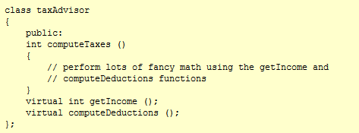
When to use inclusion?
You need to modify functionalities for the composed class

Slide 34
When to use inclusion?
A legitimate, long-term use for private inheritance:
you want to build a class Fred that uses code in a class Wilma
the code from class Wilma needs to invoke member functions from your new class, Fred
In this case, Fred calls non-virtuals in Wilma, and Wilma calls (usually pure virtuals) in itself, which are overridden by Fred

Slide 35
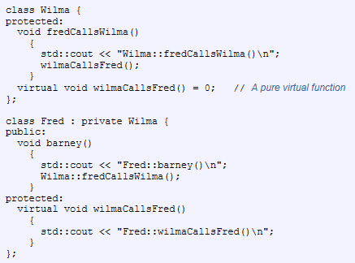

Slide 36
Why is there the protected inheritance?
protected inheritance allows derived classes of derived classes to know about the inheritance relationship
Your grand kids are effectively exposed to your implementation details
Benefits: it allows derived classes of the protected derived class to exploit the relationship to the protected base class
Costs: the protected derived class can't change the relationship without potentially breaking further derived classes

